Slide 1
Integrating Math, Science, and the Common Core into Career and Technical Education
St. Landry Parish Schools
Jason Stark
12/12/2013

Slide 2
About me…
B.S. in Agricultural Engineering from University of Nebraska-Lincoln
Minors in Business and Computer Science
Taught Math & Science at North Central High School for 8 years
M.S. Natural Science (Physics Education) from Arizona State University

Slide 3
Agenda
CCSS Math and Science Standards
Math-Integrated Tasks
Project-Based Learning
Task & Project Development

Slide 4
Objectives
Understand how CCSS Math and Science standards/practices can be integrated into CTE courses.
Learn principles of performance tasks and project-based learning.
Develop content-area specific tasks/projects that incorporate CCSS Math and Science standards/practices.

Slide 5
Why?
All students should be mathematically fluent, no matter their career path.
Scientific reasoning and the importance of understanding and using evidence in decision-making is necessary for citizens of the 21st century.

Slide 6
Workshop Norms
I can share about CCSS practices, science standards, performance tasks, and project-based learning; but…
YOU are the experts in your content areas!
Make the workshop work for you!

Slide 7
CCSS Math Practices
Make sense of problems and persevere in solving them
Reason abstractly and quantitatively
Construct viable arguments and critique the reasoning of others
Model with mathematics
Use appropriate tools strategically
Attend to precision
Look for and make use of structure
Look for and express regularity in repeated reasoning

Slide 8
CCSS Math Standards – Middle School
Grade 7
Use ratios and proportional relationships to solve real-world problems; perform operations with fractions.
Solve real-life and mathematical problems using numerical and algebraic expressions and equations.
Solve problems involving angle measure, area, surface area, and volume.
Compare and draw inferences about populations using statistics and probability models.

Slide 9
CCSS Math Standards – Middle School
Grade 8
Use radicals (square roots) and integer exponents.
Use functions to model relationships between quantities; relate proportional relationships with linear equations.
Analyze and solve linear equations and systems of equations.
Apply the Pythagorean Theorem; solve problems involving volume of cylinders, cones, and spheres.

Slide 10
CCSS Math Standards – High School
Number and Quantity
Use the real number system (rational and irrational numbers with exponents) to reason quantitatively with units to solve problems.
Perform operations on vectors, matrices, and with complex numbers.

Slide 11
CCSS Math Standards – High School
Algebra & Functions
Write functions/equations that describe relationships and situations.
Perform operations on linear, quadratic, exponential, and polynomial functions.
Represent and solve equations, inequalities, and systems of equations (algebraically and graphically) to solve problems.
Interpret the structure and meaning of mathematical expressions; explain the reasoning used to solve equations in the problem-solving process.
Interpret functions (equations) that arise in applications in terms of the context.
Analyze functions in different representations.

Slide 12
CCSS Math Standards – High School
Geometry
Make geometry constructions and experiment with transformations in the plane.
Use trigonometric ratios and solve problems involving right triangles and angles.
Apply arc lengths and areas of circles; explain volume formulas and use them to solve problems.

Slide 13
CCSS Math Standards – High School
Statistics & Probability
Summarize, represent, and interpret data and interpret linear models.
Make inferences and justify conclusions from surveys, experiments, and observational studies.
Use probability models to determine likelihood of events and evaluate outcomes of decisions.

Slide 14
Next-Generation Science & Engineering Practices
Asking questions and defining problems
Developing and using models
Planning and carrying out investigations
Analyzing and interpreting data
Using mathematics and computational thinking
Constructing explanations and designing solutions
Engaging in argument from evidence
Obtaining, evaluating, and communicating information

Slide 15
Take a few minutes
Consider the course(s) you teach:
What topics in those courses have elements of the mathematical standards?
Which topics are best suited to incorporating these math and science practices?
After you’ve made your own list, work with other teachers in your content area to put down a few ideas on your whiteboard to share.

Slide 16
So…
How do we better integrate math into CTE courses?

Slide 17
What is a Performance Task?
An activity that supplements a lesson
One to three class periods in length
Requires higher-order thinking and problem-solving skills
Grounded in real-world practice, by applying knowledge/skills to a new situation
Not a unit or a complete lesson
Not intended to replace curriculum
Notes:
Facilitator Notes
Clarify what exactly you mean by “Instructional Task” . A task is not a unit, nor a lesson, but it could be imbedded in a lesson. Talk about the characteristics of a task and how it might relate to a unit. A task might take one to three class periods, but not multiple weeks.
Considerations
Take time to clarify the definition of a task prior to moving forward, to ensure all educators are on the same page.
Task descriptors are on the following slide.

Slide 18
A High-Quality Task Should:
Be standards-based
Reflect strong instructional practices
Assess knowledge and skill
Prepare students for college and careers
Support continuous improvement
Elicit complex demonstrations or applications
Assess all students
Notes:
Facilitator Notes
A High Quality Instructional Task Should:
Be based on, and aligned to, standards (in this case, the CCSS for Mathematics and the Knowledge and Skill statements that apply to the Diagnostic Services Pathway)
Reflect strong instructional practices
Assess student knowledge and skill across the full performance continuum
Support a culture of continuous improvement that can guide good instruction
Prepare students for college and careers
Elicit complex student demonstrations or applications
Assess all students, including high and low achieving students and ELL students and students with disabilities
Considerations

Slide 19
Let’s Try…
With the teachers at your table, choose one of the provided example tasks.
Work together to come up with a solution.
Show your work on a whiteboard.
In 10 minutes, you will share…

Slide 20
Evaluate the Task…
Was it aligned to standards?
Did it assess student knowledge and skill effectively?
Was your understanding deepened by engaging with the problem?
Could it assess all students?

Slide 21
Tasks
Resources: http://achieve.org/ccss-cte-classroom-tasks
Several states worked with achieve.org to produce sample tasks in:
Architecture/Pre-Design
Agribusiness/Food Products & Processes
Health Sciences
Many more tasks are available.
You will have an opportunity to explore and develop an application task later.

Slide 22
More Task Sources
NYC Searchable Task Database: http://schools.nyc.gov/Academics/CommonCoreLibrary/TasksUnitsStudentWork/default.htm
Inside Mathematics: http://www.insidemathematics.org/index.php/mathematical-content-standards
MARS Tasks: http://map.mathshell.org/materials/index.php
Many others available by searching Google.

Slide 23
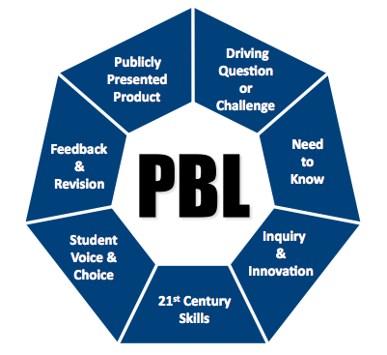
Project-Based Learning

Slide 24
Project-Based Learning
Authentic, real-world, or perplexing problems, differentiated according to student interests
Provokes students to grapple with the key concepts of a topic or discipline
Driven by student research, production, and presentation of information
Allows reflection upon decisions and outcomes during the learning process

Slide 25
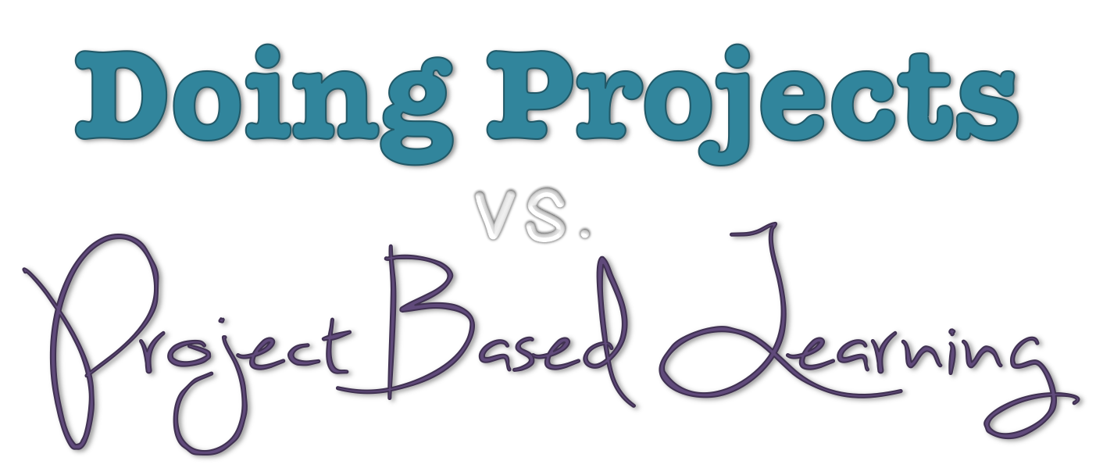
Many teachers assign projects,
but not all projects lead to learning

Slide 26
What is Project-Based Learning? (bie.org)
Focus on Significant Content
The project imparts important, standards-based knowledge and skills
Develop 21st Century Skills
Critical thinking, problem-solving, collaboration & communication

Slide 27
What is Project-Based Learning? (bie.org)
Engage Students in In-Depth Inquiry
Rigorous, extended process of asking questions, using resources, and developing answers
Organized Around a Driving Question
Focused by an open-ended question that captures the task and is explored by students

Slide 28
What is Project-Based Learning? (bie.org)
Establish a Need to Know
Students see the need to gain knowledge, understand concepts, and apply skills
Encourage Voice & Choice
Students are allowed to make choices about how they work and the products they create

Slide 29
What is Project-Based Learning? (bie.org)
Incorporate Revision and Reflection
Use feedback to consider additions and changes; think about what and how they are learning
Include a Public Audience
Present their work to other people, beyond their classmates and teacher

Slide 30
Successful CCSS Projects
Rigorous: build content knowledge
Require students to have a thorough understanding of key instructional objectives in order to complete the project
Involve reasoning, critiquing, reflecting, and evaluating evidence
Use technology appropriately and effectively

Slide 31
Project-Based Learning
Example: Opening a New Restaurant
Nutrition: Plan a menu
Math: Determine costs (food, labor, supplies) and revenues for the business plan
Business: Determine startup costs, financing, and breakeven/payoff period
Marketing: Create advertisements
Students present their projects to “investors” or community members

Slide 32
Types of Projects
Investigation of a Historical Event or Natural Phenomenon
Should the U.S. have dropped the atomic bomb on Japan?
How might animals evolve in a changing climate?
How has the national debt been affected by wars?

Slide 33
Types of Projects
Problem-Solving Situation
How can a family eat for a week on a strict budget?
What temperatures are appropriate to store food to prevent food-borne illness?
When is the best time to harvest apples to maximize starch content?

Slide 34
Types of Projects
Examination of a Controversial Issue
Should the government subsidize production of ethanol?
Should the Fed continue its policy of economic stimulus?
Should companies and scientists receive patents for genes and crop varieties?

Slide 35
Types of Projects
Challenge to Design, Plan, Build, or Create Something
Design and build ___________.
Create a business plan for a new fashion line.
Develop a way to evaluate methods of reducing coastal or soil erosion.

Slide 36
Think about a project you assign…
Rate your project based on the provided criteria

Slide 37
Project Upgrade
Consider one of the projects you assign in your classes. Think about how you can…
Make a “dessert” project into a “main course” project
Integrate more math and science skills and practices into the project (and assess them)
Guide students toward a product that demonstrates understanding
Be ready to share in 10 minutes…

Slide 38
Work Time…
Work in content-area teams.
Consider a topic you’ll be teaching in the next couple months.
Design a task or project that integrates CCSS math standards and practices with this topic.
Use the ‘Project/Task Design Worksheet’ handout as a guide.
Be prepared to share your project idea.

Slide 39
Sharing
Each team, please take a few moments to share your project ideas.
How will you engage your students in this project?
What will students be required to do?
How is math/science integrated?
Is it rigorous? Can students complete the project without understanding the key math ideas?
How do you assess students? What is/are the deliverable(s)?

Slide 40
Note: Whiteboarding
I use whiteboarding often in my classes.
Presentations require students to share their reasoning and justify their claims
Allow students to ask questions of each other (critiquing) and respond logically
Active, peer-driven learning process
Formative assessment – gets students talking to each other about the content
COMPASS

Slide 41
Thank You!

